Slide 1
Objectives
Easy to finding blood donors
Time saving
User friendly for mobile users

Slide 2
Abstract
Blood Bank can be used effectively for getting the details of blood donors having the same blood group and with in the same city. With the help of my Online Blood Bank people who are having the thought of donating blood gets registered in my Online Blood Bank giving his total details.
It also provide mobile view for the user who use this site from Their mobile.as the number of people who uses mobile is increasing now a day it can reach as many people there by increasing it’s use

Slide 3
Introduction
Blood Bank can be used effectively for getting the details of blood donors having the needed blood group and with in the native city. With the help of my Online Blood Donation Management System people who are having the thought of donating blood gets registered in my Online Blood Bank giving his total details.
also helps people who are in need of blood by giving the details of the donors by searching, if at all there are no donors having the same group and with in their own city they will be given the addresses with phone numbers of some contact The number of persons who are in need of blood are increasing in large number day by day.

Slide 4
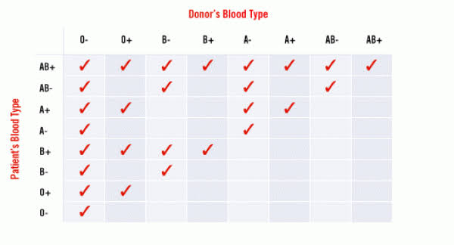
Blood Matches

Slide 5
System Requirements
HARDWARE REQUIREMENTS
Processor : Intel Core i7
Screen Size : 13.3 inch
Keyboard : 104 Keys
RAM : 4 GB RAM
Mouse : (Any Optical Mouse)
Hard Disk : 1 TB
SOFTWARE REQUIREMENTS:
Operating System : Windows 8
Front-End Tool : PHP
Back-End Tool : MYSQL

Slide 6
Architecture Design
OBDMS
Home
Register
Search blood
Contact As
Admin
About As
donor
Registration
Search blood
group
User query
login
dashboard
Read query
Donor
list
Sms send
Logout

Slide 7
Database Design
Table 1 Admin
COLUMN NAME | DATATYPE | CONSTRAINT
Id | Int(4) | Primary key
Name | Varchar(30) | Not null
Password | Varchar(10) | Not null
Table 2 tblbloodgroup
COLUMN NAME | DATATYPE | CONSTRAINT
Id | Int(4) | Primary key
Blood group | Varchar(5) | Not null
Position date | Timestamp | Not null

Slide 8
Database Design
Table 3 tblblooddonor
COLUMN NAME | DATATYPE | CONSTRAINT
Id | Int(4) | Primary key
Full_name | Varchar(20) | Null
Mobile no | Int(10) | Unique key
E-mail_id | Varchar(20) | Null
Gender | Varchar(10) | Null
Age | Int(2) | Null
Blood group | Varchar(5) | Not null
Address | Varchar(100) | Null
Message | Text | Null
Position date | Timestamp | Not null

Slide 9
Database Design
Table 4 tblcontactdetail
COLUMN NAME | DATATYPE | CONSTRAINT
Id | Int(5) | Primary key
Name | Varchar(30) | Not null
E-mail_id | Varchar(25) | Null
Address | Varchar(100) | Not null

Slide 10
Database Design
Table 5 tblcontactinfo
COLUMN NAME | DATATYPE | CONSTRAINT
Id | Int(4) | Primary key
Name | Varchar(25) | Not null
E-mail_id | Varchar(30) | Null
Contact number | Int(10) | Not null
Message | Text | Null
Position date | Timestamp | Not null

Slide 11
Database Design
Table 6 tblpages
COLUMN NAME | DATATYPE | CONSTRAINT
Id | Int(4) | Primary key
Page name | Varchar(10) | Not null
Type | Varchar(20) | Null
Detail | Varchar( 100) | Not null

Slide 12
Module Description
Home
Search Blood
Become A Donor
Contact Us
Admin

Slide 13
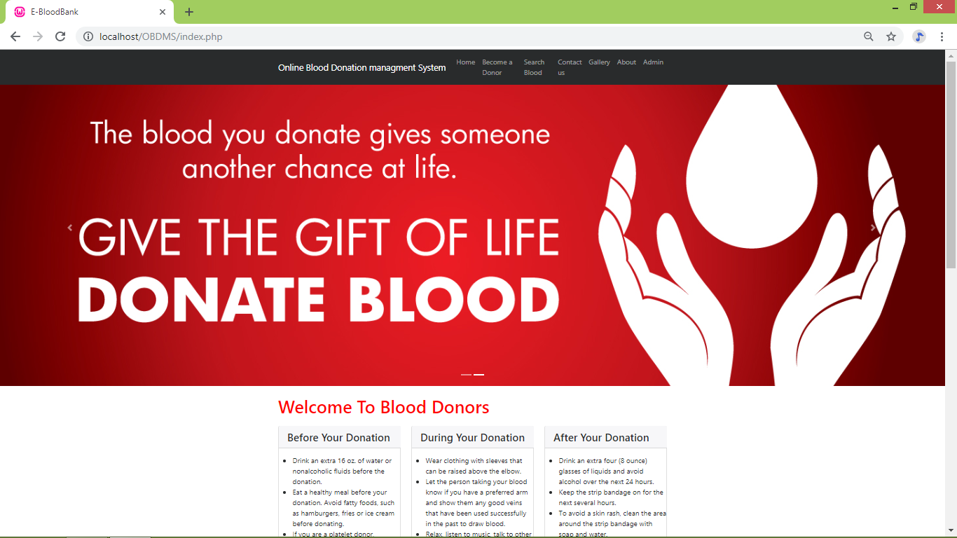
Home

Slide 14
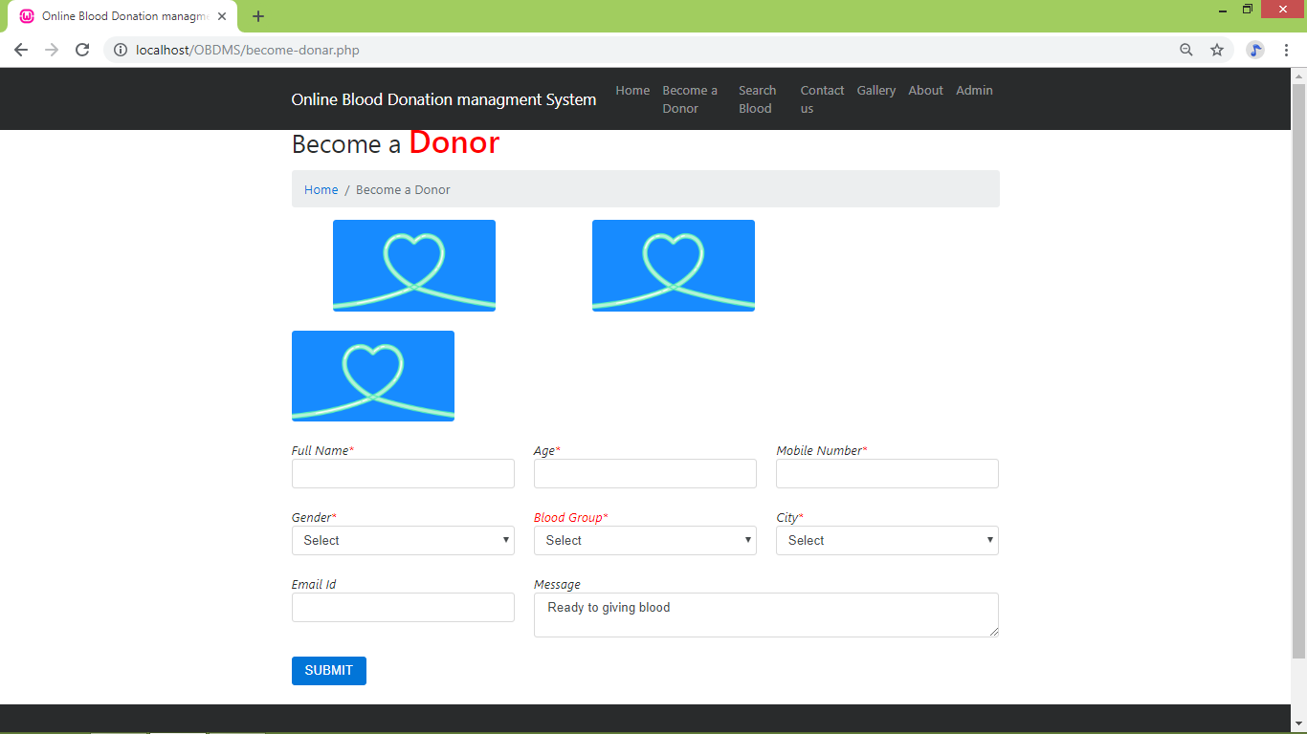
Become a Donor

Slide 15
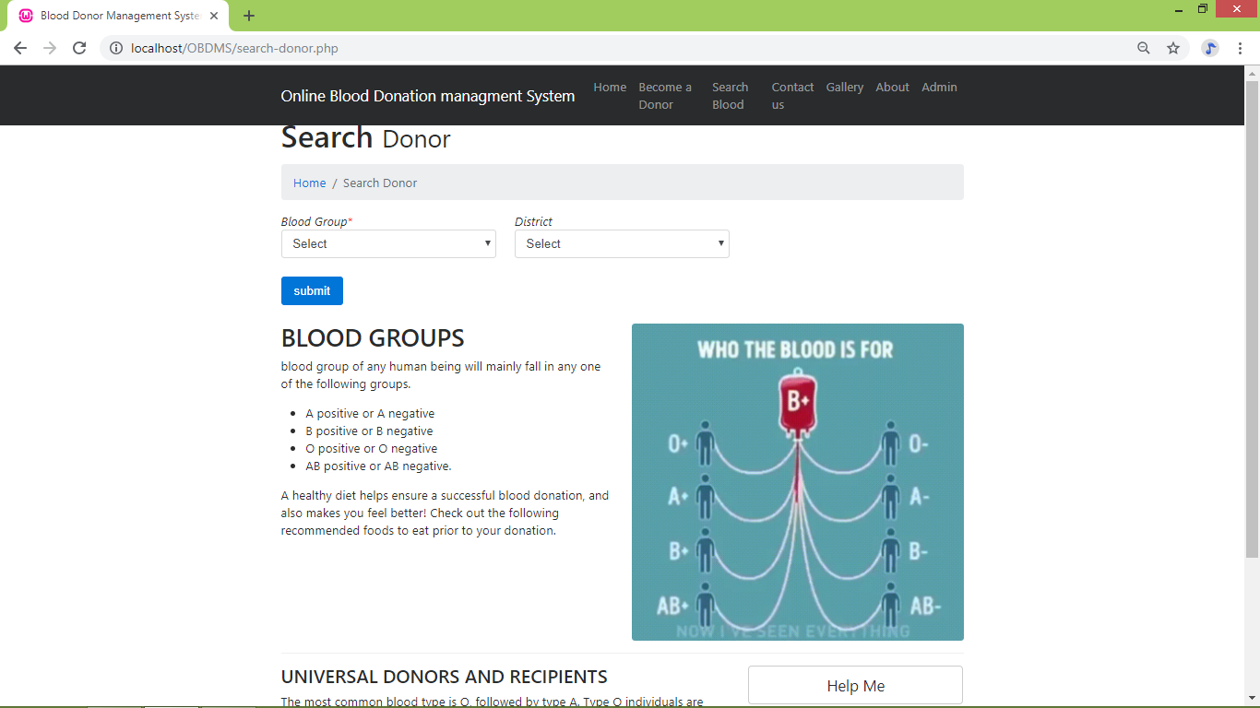
Search Blood group

Slide 16
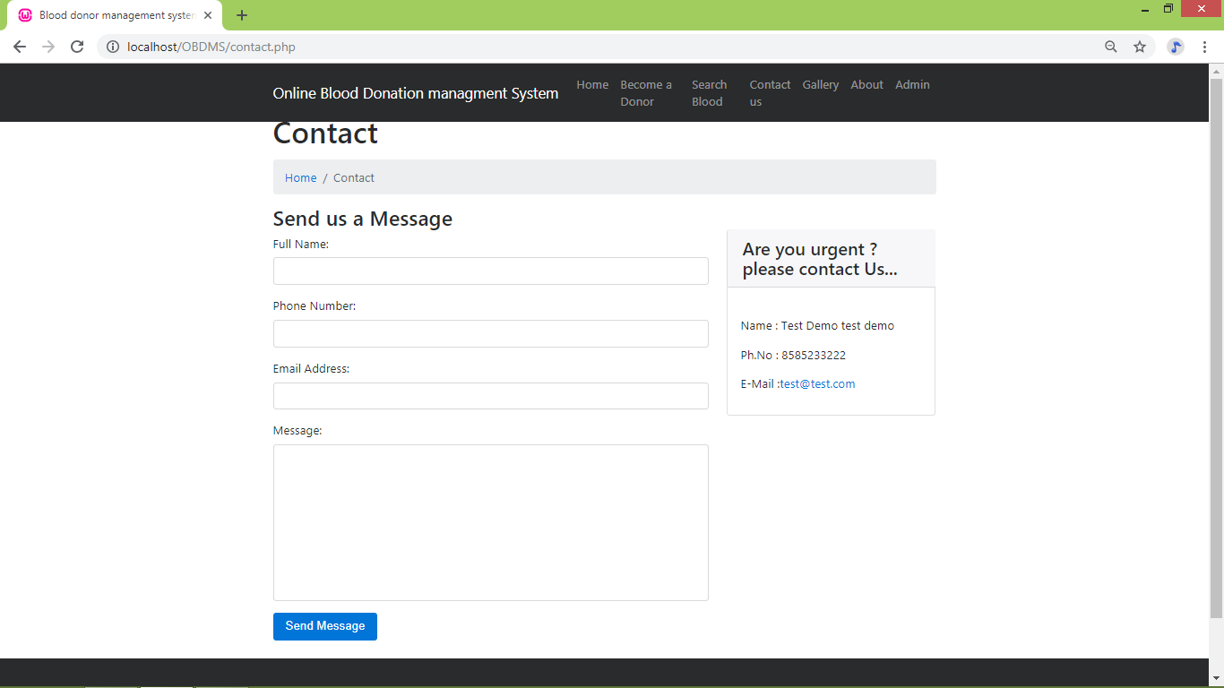
Contact As

Slide 17
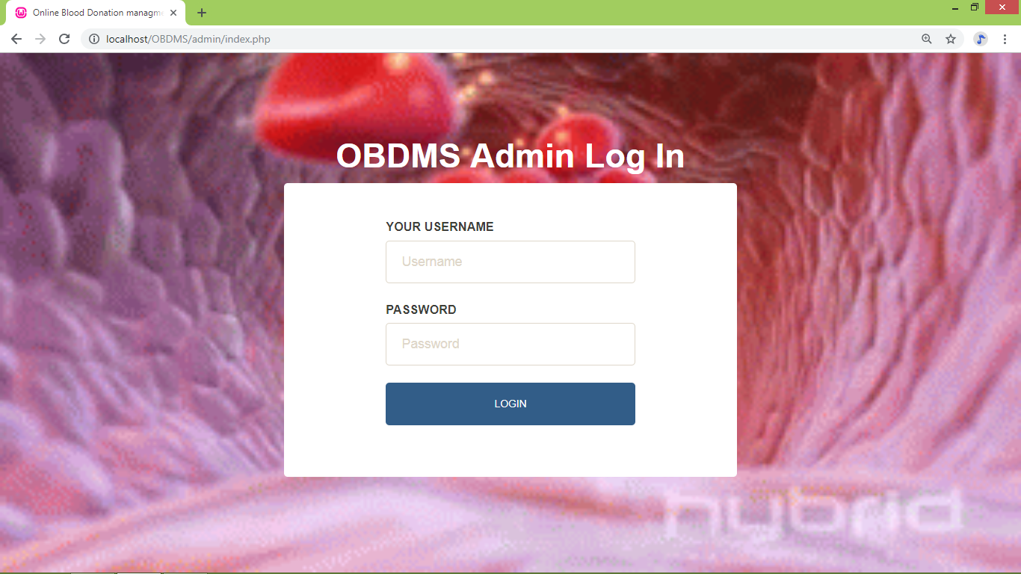
Admin

Slide 18
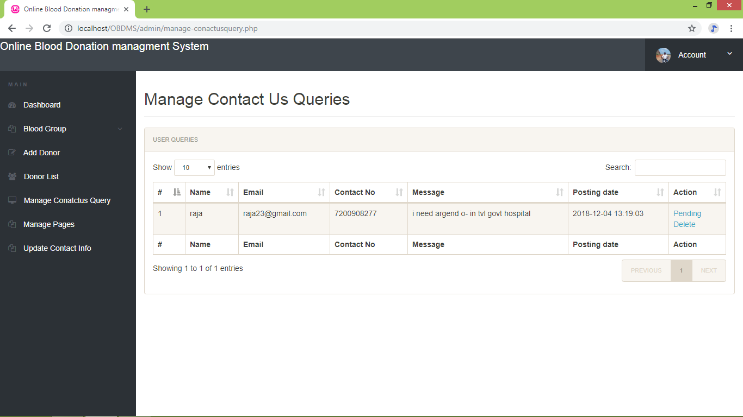
ManageContactQuery

Slide 19
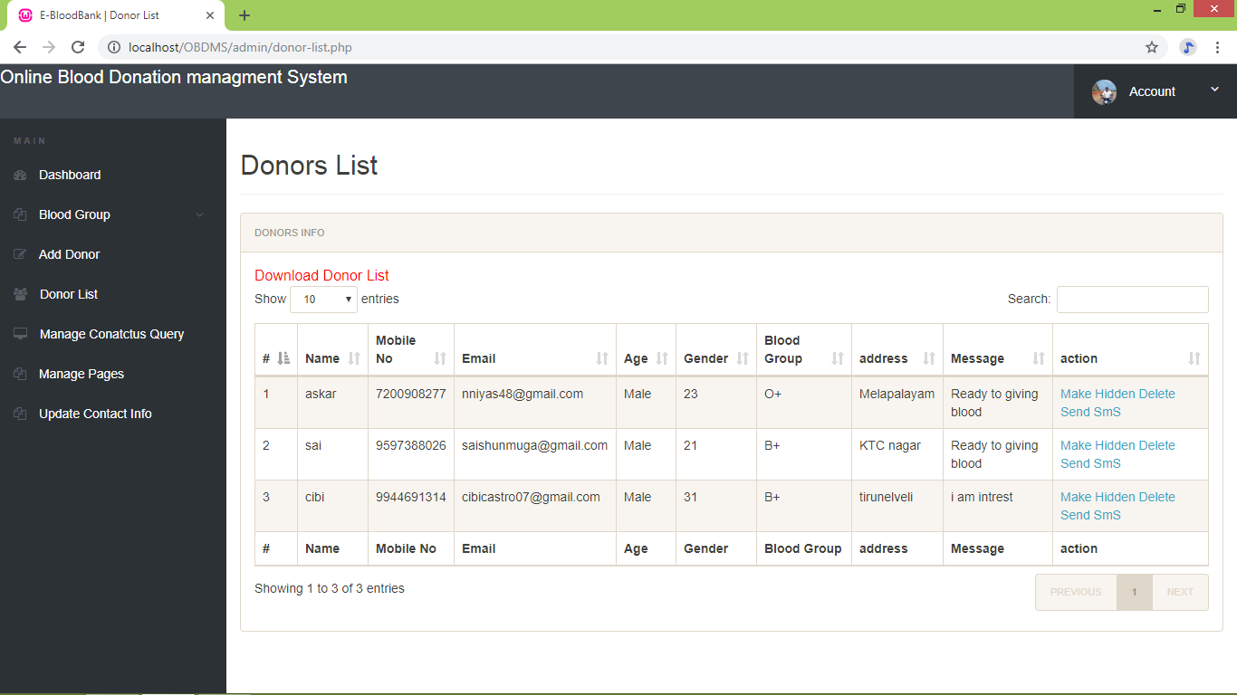
Donor list

Slide 20
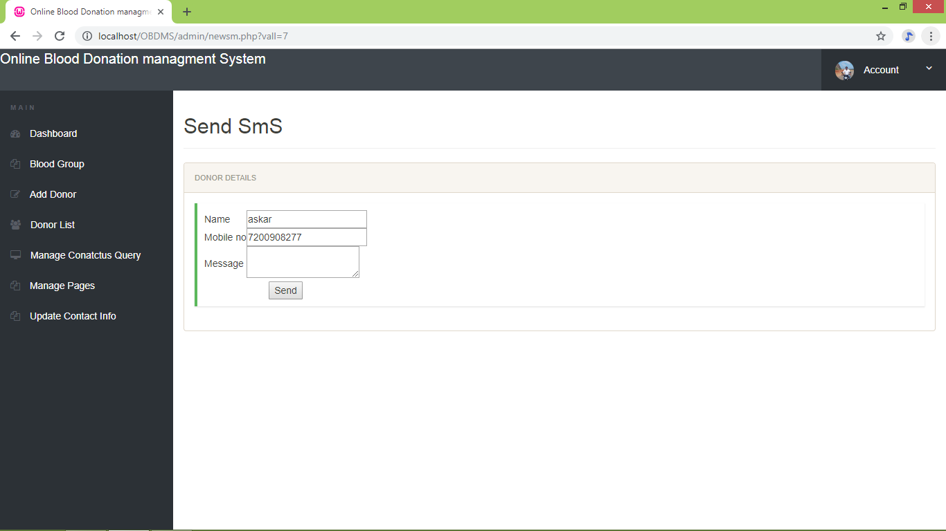
Send Sms

Slide 21
CONCLUSION
The online blood donation management system actives are into three major parts
these are Donor , User &Admin
In this system user can View the Donor details with login
This System have the message alert system
It helps alert the donor

Slide 22
FUTURE ENHANCEMENT
As there was a little number of contact person’s information given, some people may face difficulty in getting blood fast. So i like to gather more information regarding the contact persons in other cities as well as villages and will provide much more services for the people and help everyone with humanity.
The system can be made more use for user using image maps methods

Slide 23
REFERENCES
BOOKS
The Joy of PHP programming: A Beginner’s Guide – by Alan Forbes.
PHP & MYSQL novice to ninja – by Kelvin Yank.
Learning PHP, MYSQL, JavaScript and CSS: A step-by-step guide to creating dynamic websites – by Robin Nixon.
PHP & MYSQL Web development – by Luke Welling & Laura Thompson.
WEBSITES
www.codeproject.com
www.w3schools.com
www.tutorialspoint.com
www.geeksforgeeks.com
www.bulksmsgateway.in
www.stackoverflow.com

Slide 24
Thanking you

